Slide 1
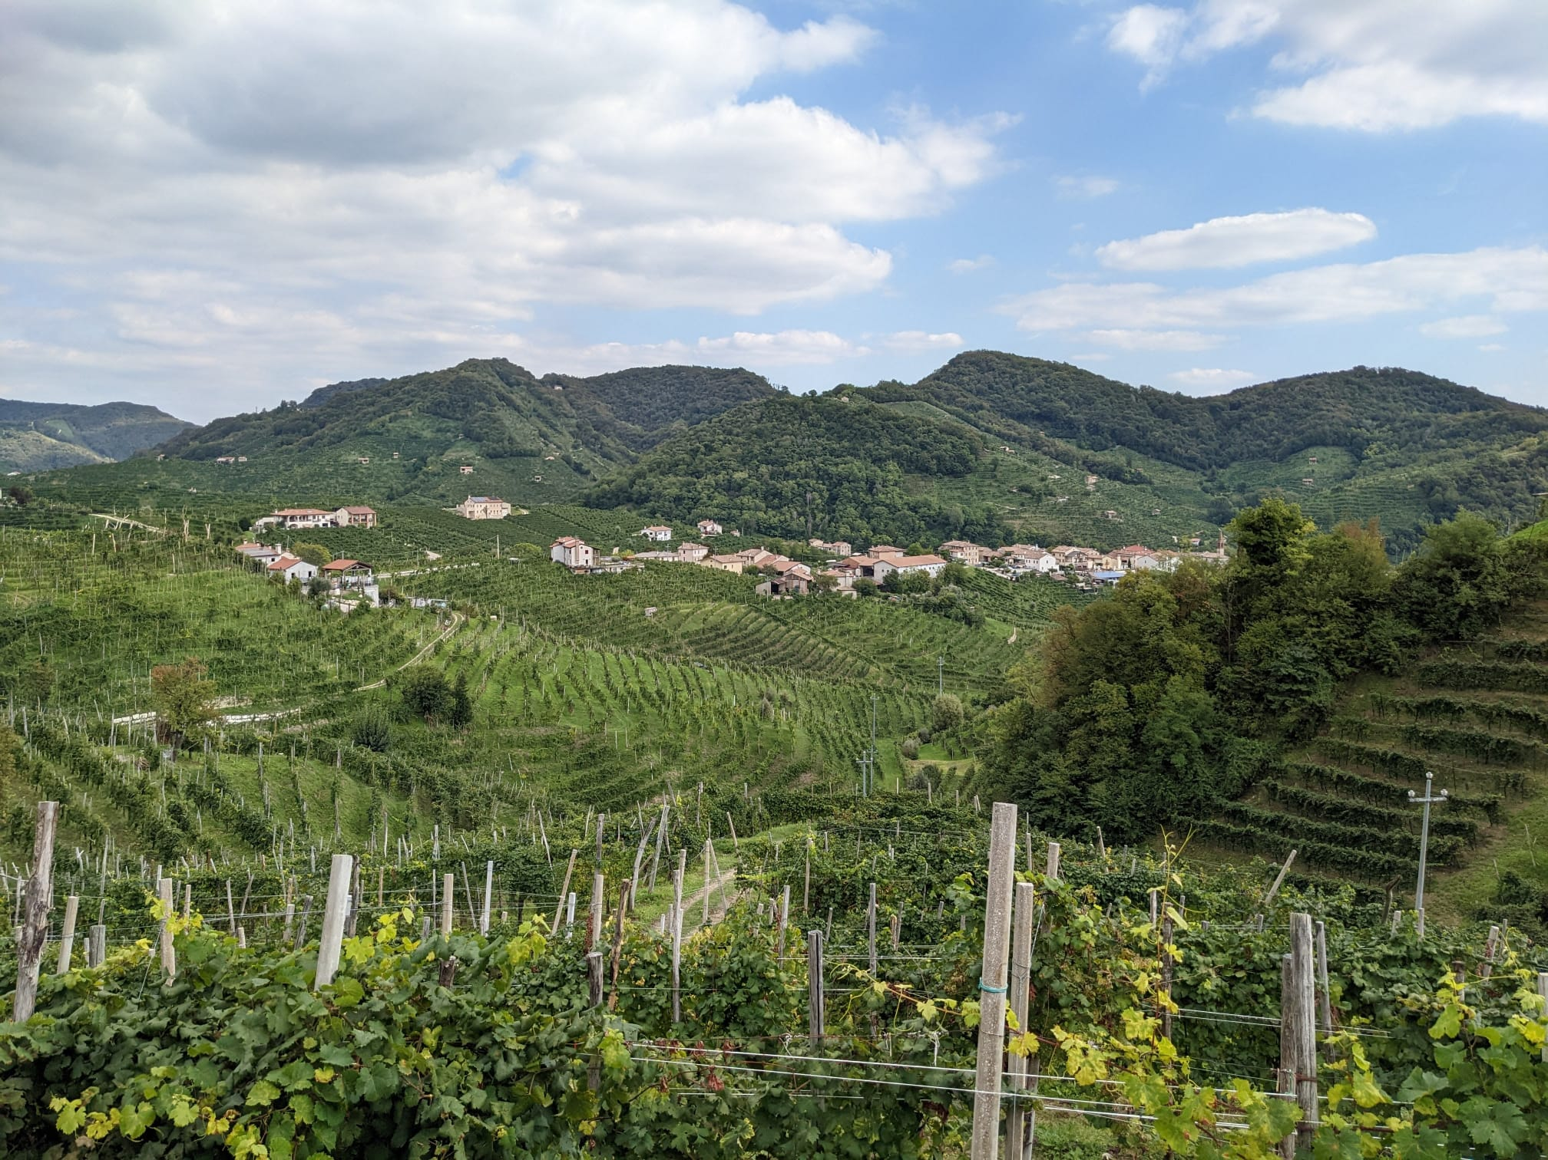
Introduction to Data Science - Team 1 Life as a winemaker
“Penicillin cures, but wine makes people happy.” – Alexander Fleming

Slide 2

We are a winemaker and want to improve our business with a new wine recommender app
We are an expert at wine making but we and want to go digital. Therefore, we offer our customers a new app for wine recommendations.
There are three main features:
Generate wine ratings for new wines
Recommend similar wines for our users based on their taste
Get an overview which flavors are currently popular

Slide 3
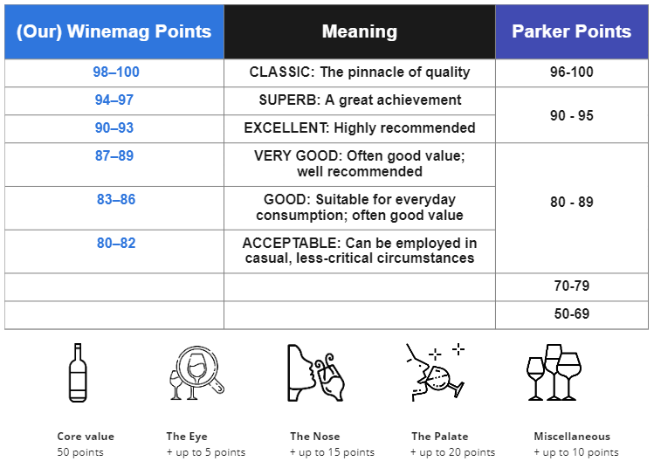
To understand how the rating works, we need to make a digression into wine rating.
“No one argues with the incontestable fact that tasting is a subjective endeavor. The measure of an effective wine critic should be his or her timely and useful rendering of an intelligent laundry list of good examples of different styles of winemaking in various price categories.”
- Robert Parker
This has been designed using images from Flaticon.com

Slide 4
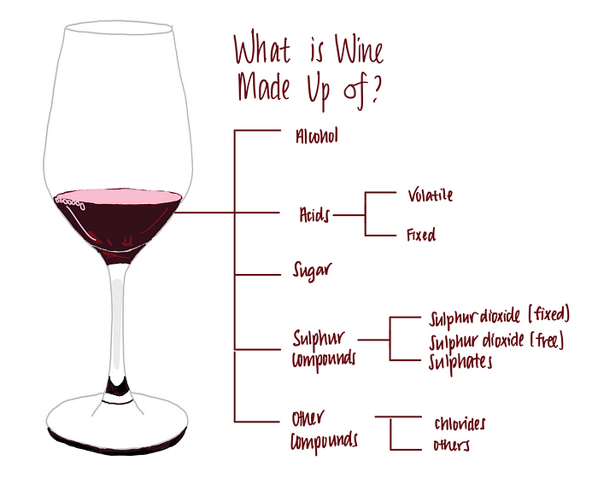
Wine is more than chemistry
When trying to predict wine quality, there are many attempts to use chemical data like alcohol, acids, sugars and other components.
The result: The more alcohol, the better¹
Tastry founder Katerina Axelsson noticed a big discrepancy in the rating of two bottles of wine from the same batch
The taste of the wine can even change during transport
That is why modern companies consider more than just the chemical components.
Image by Travis Tang from https://towardsdatascience.com/what-makes-a-wine-good-ea370601a8e4
¹ https://towardsdatascience.com/what-makes-a-wine-good-ea370601a8e4, Travis Tang, 22.10.2020

Slide 5
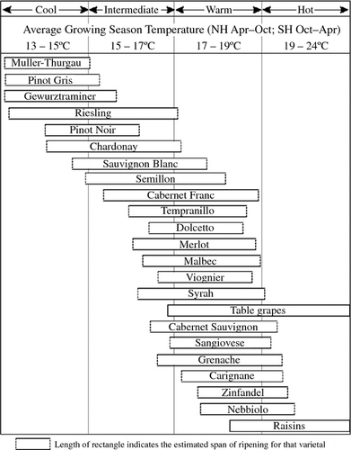
Climate has a big impact on wine quality
Based on literature, “air temperature is considered the most important factor in the overall growth and productivity of winegrapes”.¹
Warmer climates result in more alcoholic, full-bodied wines with higher sugar levels, darker color and easier ripening.²
Cool climates (less than 15 ℃) results in crisp, higher-acidity, fresher wine with lighter body, low sugar level but difficult ripening.³
¹ Jones, G. V., and F. Alves. 2012. Impact of climate change on wine production: a global overview and regional assessment in the Douro Valley of Portugal.
² Greg Spellman, Wine, weather and climate, University College Northampton, p. 230
³ Greg Spellman, Wine, weather and climate, University College Northampton, p. 230
Image: https://onlinelibrary.wiley.com/doi/10.1002/fes3.14#fes314-bib-0073, adapted from Jones, G. V. 2006. Climate and terroir: impacts of climate variability and change on wine. p. 1–14

Slide 6
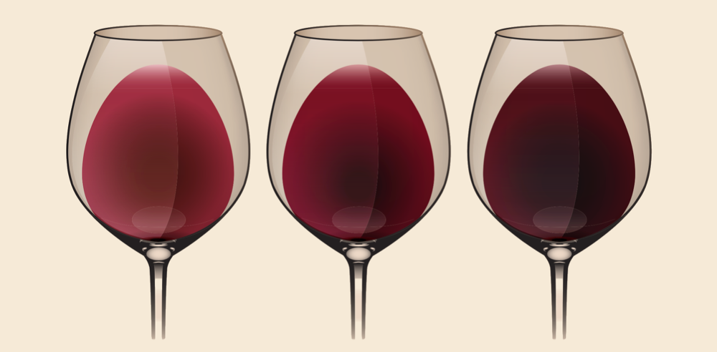
About the taste of wine and grapes
There are many ways to describe the taste of a wine. Some terms are important for our research.
“Aroma - Sometimes called the ‘bouquet’. This is essentially the smell of a wine and is frequently used to describe older wines. Common aromas associated with wines include fruit, herbs, flowers, earth, grass, tobacco, mocha and chocolate.”¹
“Tannic - Tannins are an important component of red wine. Alone, they can taste bitter, but will yield different results depending on how they’re blended with other elements of the wine.”²
“Acidity - Acid is an important component in wines – particularly whites. It gives the wine freshness and zing. The more acidic a wine, the more refreshing, crisp and mouth-watering it will feel as you drink it.”³
Types of wine³
Light Medium Strong
Low tannins Medium tannins High tannins
High acidity Medium acidity Low acidity
¹ https://www.wineinvestment.com/learn/magazine/2019/11/how-to-describe-wine-like-a-pro/, Cult Wine Investment, 13.11.2009
² https://www.wineinvestment.com/learn/magazine/2019/11/how-to-describe-wine-like-a-pro/, Cult Wine Investment, 13.11.2009
³ https://www.wineinvestment.com/learn/magazine/2019/11/how-to-describe-wine-like-a-pro/, Cult Wine Investment, 13.11.2009
⁴ https://cdn.shopify.com/s/files/1/0039/7449/6329/files/Weinfarbe-Tannin-Gerbsaeure-Gerbstoff_1024x1024.png?v=1547806867, Wine Amigos, 01.02.2019

Slide 7
First step: Get the data
We got the source dataset from: https://www.kaggle.com/datasets/zynicide/wine-reviews.
The data was scraped from the website WineEnthusiast on November 22nd, 2017.
11 editors of the website wrote wine reviews and distributed points from 80-100.
The dataset has 130.000 observations and 14 columns.
We extracted more information and added weather data:
First, we extracted additional information from the source dataset such as the year from the wine title (RegEx)
Then we determined the geographical location based on the country and province of the wine (Open Weather Map API)
Finally, we obtained weather data for the specific year and growing season of the wine (Meteostat API)
We also wanted to learn more about the reviewers and got the number of their Twitter followers (Twitter API)
In addition, we labelled most of the wines according to their grape variety with white and red (manual)

Slide 8
EDA | Descriptive Statistics

Slide 9
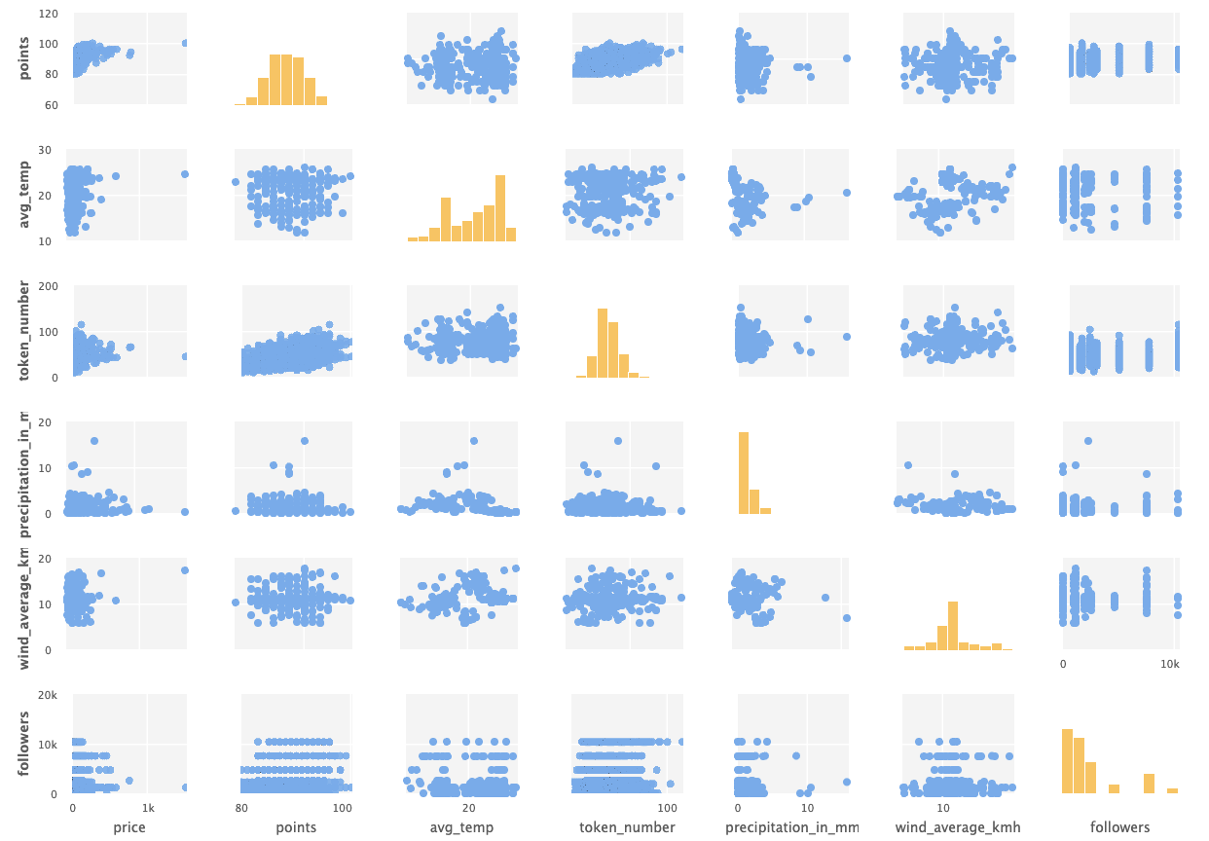
EDA |Scatter Matrix
Small amount of outliers regarding price, temp and wind
Positive correlations
points-price
points-token_number
Surprisingly no obvious correlation between weather and wine data
Correlation Matrix showed high values for weather data

Slide 10
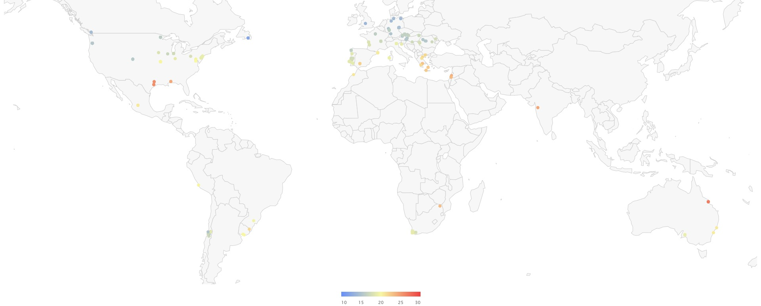
EDA | Distribution wine regions
Literature review revealed highest amount of wine production (Tonnes per year) in Italy and Spain.
Hence distribution of regions from dataset indicates possible discrepancy to real world.

Slide 11
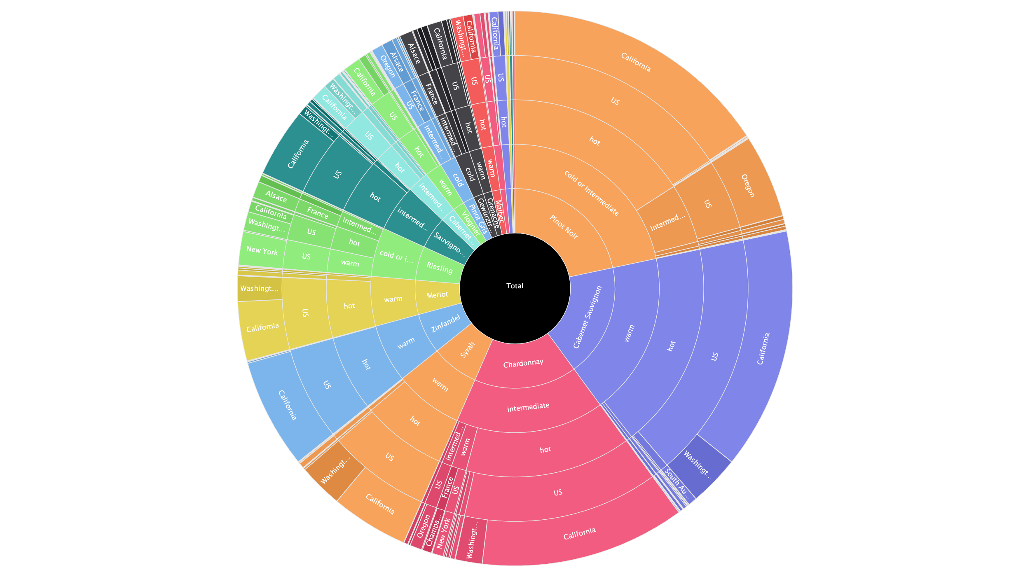
EDA | Distribution varieties
1st: Variety
2nd: Temperature according to literature (2007)
3rd: Temperature according to our data
4th: Country
5th: Province
Over 50% of dataset consits of only three varieties
Temperatures (here from 2022) are most time 1-2 levels higher than expected
US (California) is the dominant Country

Slide 12
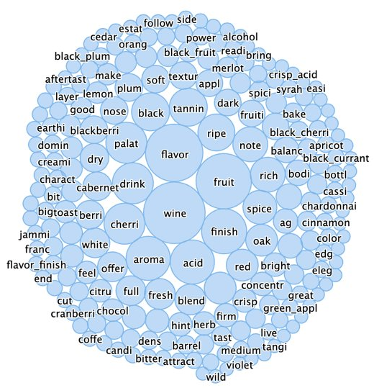
EDA | Wine descriptions
The wine has a rich taste of cherry and black plum.
Intense red color like ripe cherries.
n-grams
black_plum
Stemming
cherri
Filtering
Wine, Winemaker,...
Stop word removal
Tokenize
Intense|red|color|like|ripe|cherries

Slide 13
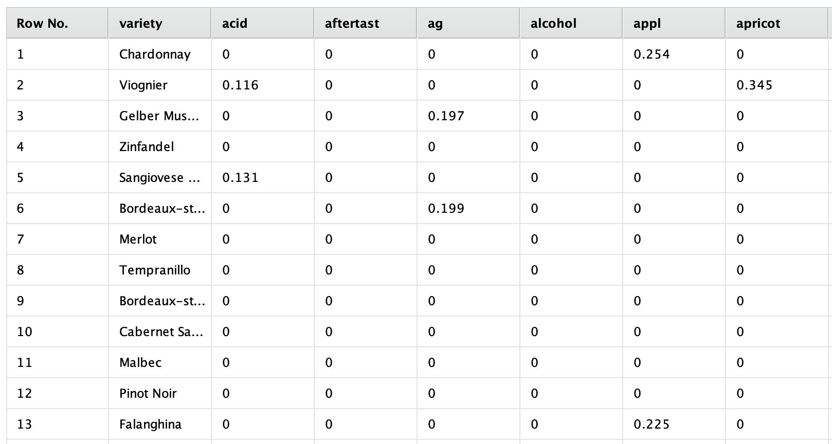
Conversions and Transformation
Text processing
Tokenization of wine descriptions to generate a Term Document Matrix (TDM) for Term frequencies or counts
Via TDM it is possible to derive further informations:
word count: numeric value for linear regression
key words identification: term frequencies for Content-Based Recommendation Engine and Clustering
Term identification for wine color
Normalization of numeric variables due to different units to enable consistent comparison

Slide 14
Data Quality
Attribute “points” is a subjective opinion of one tester
Getting weather information with API was a lot of effort and is not very accurate - only on province. Therefore, many wines have the same temperature.
It’s especially difficult to get historic weather data (for free)
Imbalanced dataset (~ 2x more red than white wines, a lot from US/California)
Data cleansing -> no quarantining outliers, no substitution of missing values
2600
2,476
2400
2200
2000
1800
1600
1400
Count(id)
1200
1,138
1000
800
600
400
200
0
white
red

Slide 15
Brief Summary of Use Cases
Use Case 1: Linear Regression
As the administrator of the Wine app, we want to analyze the direct and indirect factors that are considered in wine ratings and observe their impact on the ratings.
Use Case 2: Content-Based Recommendation Engine
In order to increase user satisfaction and continuously improve the usage rate of the wine app, we want to analyze users' wine preferences and recommend suitable wines.
Use Case 3: K-Means Clustering
Generally, it is assumed that the taste of grapes causes differences in aroma and taste of wine, so we want to analyze and classify the taste by grape variety.

Slide 16
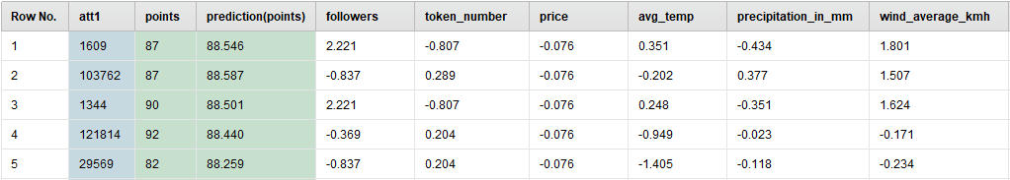
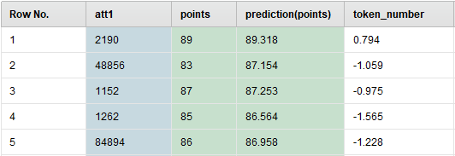
Use Case 1: Linear Regression Analysis
How to implement:
Case-specific data preparation
Apply the linear regression method and check its performance
Normalize (Z-Transformation)
Forward Selection: Reducing the number of attributes for better performance
Final table – 1. Regression Model
Final table a– After forward selection

Slide 17
Use Case 1: Linear Regression Analysis
Performance evaluation:
P-Value: The coefficients of some attributes are statistically significant.
Goodness of fits in regression model: Squared correleation (adjusted R²) = 0.188 +/- 0.034
Performance evaluation
P-Value The coefficients of token number is statistically significant.
Goodness of fits in regression model: Squared correleation = 0.164
Linear Regression
Attribute | Coefficient | Std. Error | P-Value | Code
Intercept | 88.391 | 0.056 | 0 | ****
Average Temperature | 0.069 | 0.064 | 0.278
Precipitation in mm | -0.161 | 0.063 | 0.011 | **
wind_average_kmh | 0.122 | 0.057 | 0.033 | **
Price | -0.143 | 0.056 | 0.011 | **
Followers | 0.357 | 0.057 | 0.000 | ****
Token number | 1.177 | 0.056 | 0 | ****
After forward selection​
Attribute​ | Coefficient​ | Std. Error​ | P-Value​ | Code​
Intercept​ | 88.391​ | 0.057 | 0​ | ****​
Token number | 1.167 | 0.057 | 0​ | ****​

Slide 18
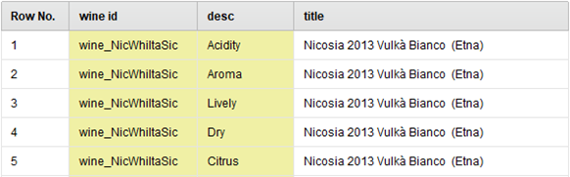
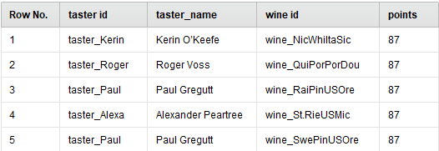
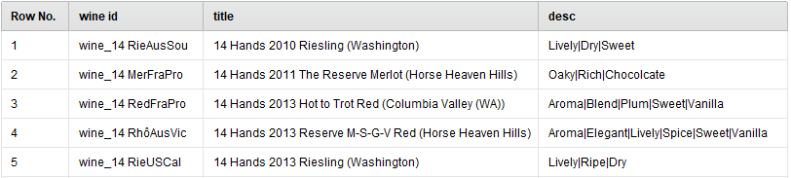
Use Case 2: Content-Based Recommendation Engine
How to implement:
Case-specific data preparation
Generating Wine and Taster ID
Generating Item profile table
Set user & item identification & attribute identification and label
Item attribute K-NN
Apply Model (Rating Prediction)
Rating matrix table
Item profile table

Slide 19
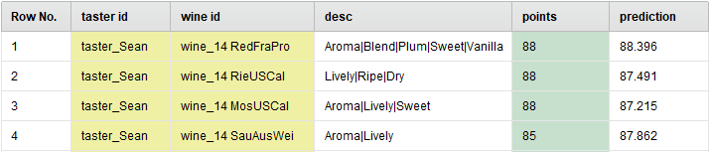
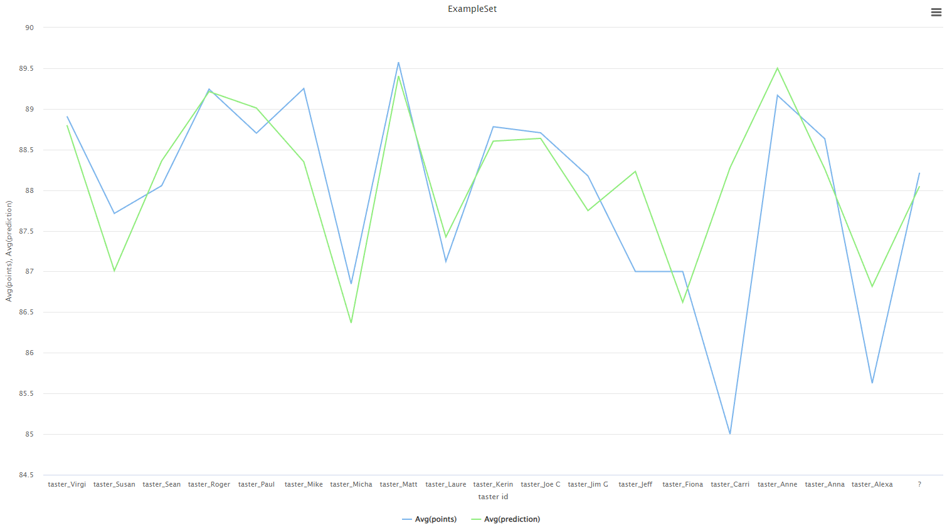
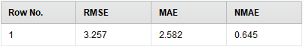
Use Case 2: Content-Based Recommendation Engine
In general, this recommendation engine worked well.
The predicted rating is close to the actual rating provided by the users.
The performance of this model depends heavily on the number of user reviews.
Performance evaluation operator

Slide 20
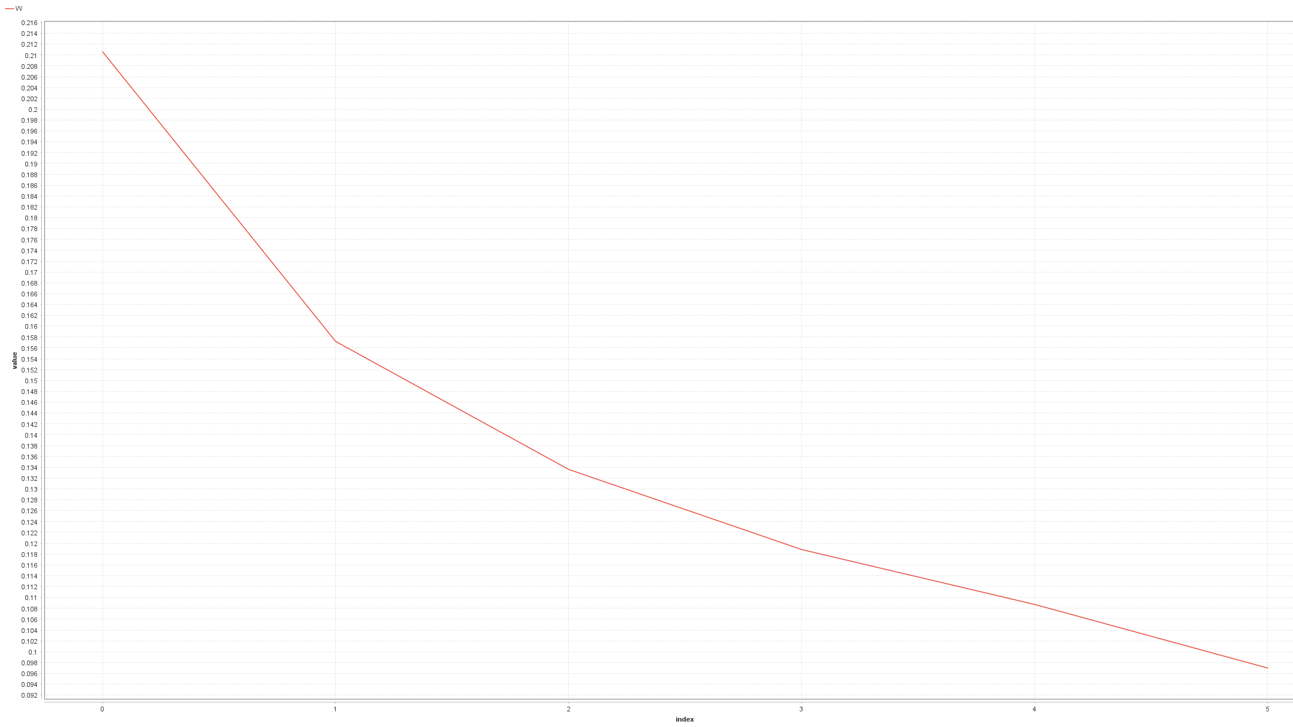
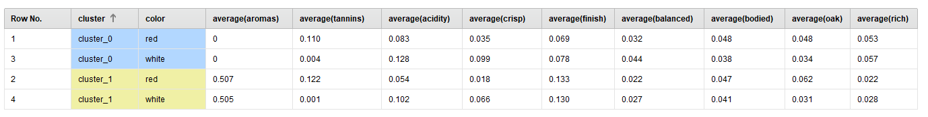
Use Case 3: Clustering
How to implement:
Case-specific data preparation
Iterate through all parameter combinations to find the optimal number of clusters
Elbow method (we decided for k=2)
Apply k-mean clustering
Group data (average aggregation) on cluster and grape color
Clusters:
1 2 3 4 5 6

Slide 21
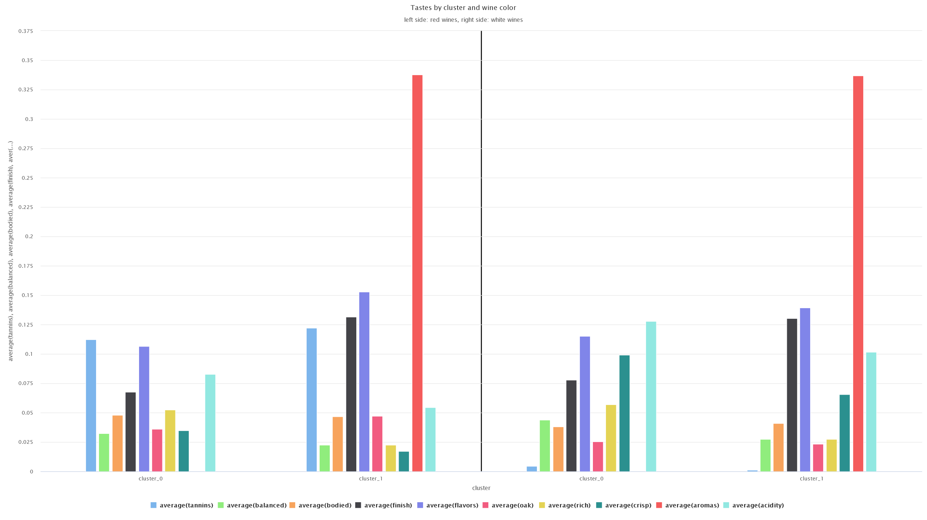
Use Case 3: Clustering
The tastes of the wines partly match the characteristic grape tastes from literature:
Red wines tend to have flavors: Tannins, Oak
White wines tend to have flavors: Crisp, Acidity
The clustering was not able to distinct red and white wines
Clustering is mainly based on aromas
red grapes
white grapes

Slide 22
Thank you for your attention.

Slide 23
Use Case 1: Linear Regression Analysis
Summary of the use case
As the manager of a wine app, we want to know what the direct and indirect factors determine the ratings given to wine by users. Therefore, we want to avoid subjective factors, such as individual users' tastes in wine, and select objective factors as much as possible to analyze their impact on ratings.
Case-specific data preparation
Weather data, containing:
Average temperature of harvest year
Precipitation in mm of harvest year
Wind average km/h of harvest year
Number of Tokens in customer reviews

Slide 24
Use Case 2: Content-Based Recommendation Engine
Summary of the use case
Roger Voss is the most top user of our wine app. To increase this user's satisfaction and continue to improve his usage rate, we would like to analyze his wine preferences and give him suitable wine recommendations.
Case-specific data preparation
Rating matrix table
Wine ID, User ID, Points
Item profile table
Wine ID, Title, Description
Using text processing, we recognize the specific words associated with the wine description in the user review. Based on this, we generated a new description column.

Slide 25
Use Case 3: Clustering
Summary of the use case
Users of wine apps who have little wine experience do not know how the aroma and taste of wine differ depending on the type of grape. Therefore, we try to identify the basic preferences of these users by clustering the taste and aroma of various wines and analyzing the characteristics that stand out according to the color of wine.
Case-specific data preparation
Wine color table
Variety of grapes
Color of the grape (Red, White)
Text processing
We extracted the words to describe wine according to literature from the wine description field to help classify each wine's flavor

Slide 26
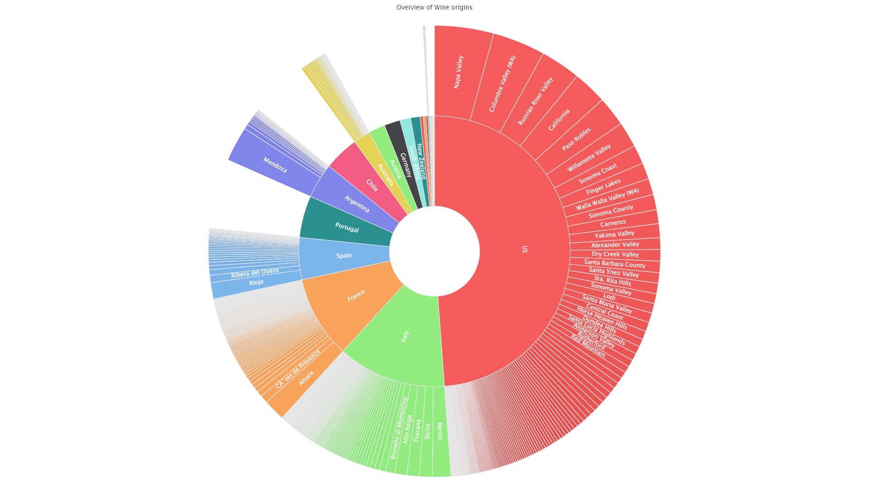
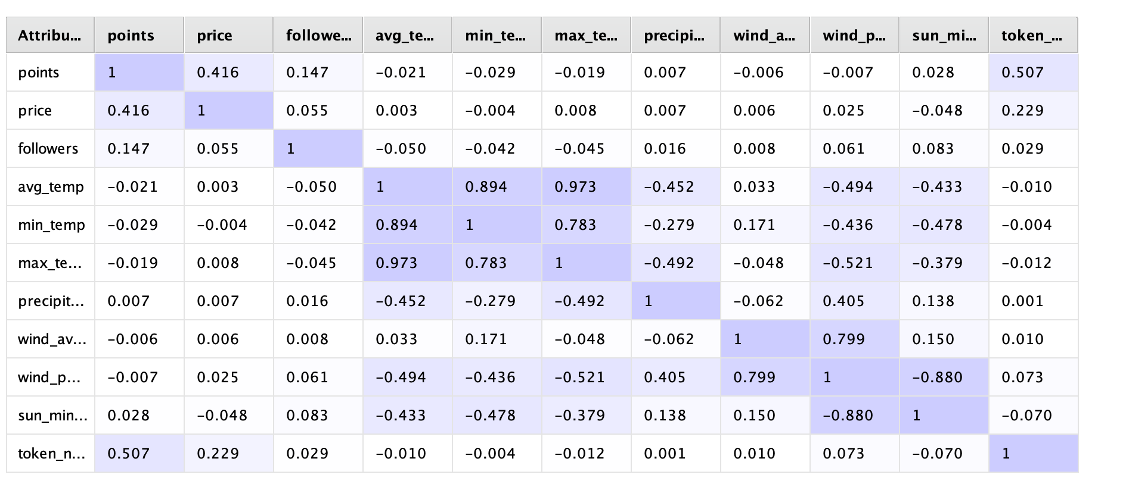
EDA | Backup

Slide 27
